Slide 1

Bioinformatics and Medicine
Jeremy Yang
Associate Instructor IU School of Informatics and Computing
Instructor: Prof. Joanne Luciano
DATA SCIENCE FOR DRUG DISCOVERY, HEALTH AND TRANSLATIONAL MEDICINE (DSDHT) INFO I-590

Slide 2
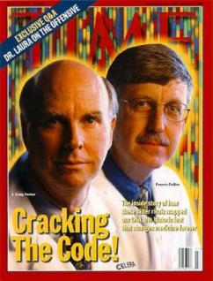
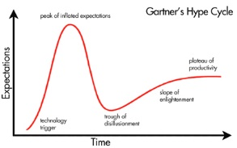
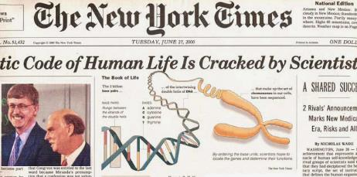
Bioinformatics and Medicine: Hype vs Reality
“What more powerful form of study of mankind could there be than to read our own instruction book” – Francis S. Collins, Director, NIH.
HGP: Craig Venter and Francis Collins, 2000

Slide 3
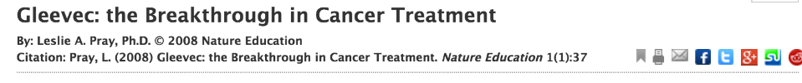
Bioinformatics and Medicine: Gleevec, a motivating example
"Some say it's a miracle drug. Others call it a silver bullet. Gleevec, also marketed internationally as Glivec and sometimes referred to by its chemical name imatinib, entered the medical world with a bang. This medication was initially approved for use by the U.S. Food and Drug Administration (FDA) in 2001 for the treatment of chronic myelogenous leukemia (CML), a rare form of cancer that affects certain types of white blood cells. Since its initial approval, Gleevec has also been approved for use in patients with several types of gastrointestinal tumors. Currently, scientists continue to study the drug's effectiveness not only in various cancers, but also in other diseases, such as stroke (Su et al., 2008)."
From Scitable, by Nature Education, NPG,
http://www.nature.com/scitable/topicpage/gleevec-the-breakthrough-in-cancer-treatment-565

Slide 4
Bioinformatics and Medicine: Gleevec
Gleevec inhibits a tyrosine kinase, a protein involved in cell division.
Acute myelogenous leukemia (AML) associated with chromosomal abnormality in leukocytes (1950s, cytogenetics), a somatic mutation involving the BCR and ABL genes (1980s, sequencing).
The mutated ABL is an oncogene, BCR+ABL expressed in the abnormal tyrosine kinase which causes AML.
From Scitable, by Nature Education, NPG,
http://www.nature.com/scitable/topicpage/gleevec-the-breakthrough-in-cancer-treatment-565

Slide 5
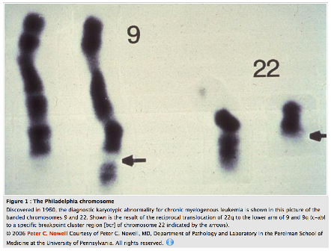
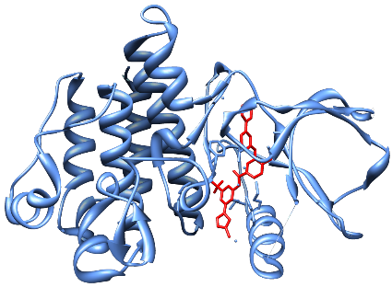
Bioinformatics and Medicine: Gleevec
ABL1 with Gleevec in ATP binding site
The Philadelphia chromosome
From Scitable, by Nature Education, NPG,
http://www.nature.com/scitable/topicpage/gleevec-the-breakthrough-in-cancer-treatment-565
Notes:
(In 1998) this chemical, which was called ST1571 and eventually renamed Gleevec, entered its first clinical trial: a small phase I trial involving just 31 patients. Remarkably, all 31 individuals experienced complete remission; in other words, their blood counts returned to normal. In some of these patients, there was also cytogenetic remission, meaning that the Philadelphia chromosome was no longer found in their blood cells. As Druker noted, "That was virtually unheard of in a phase I clinical trial. Usually in a phase I clinical trial, if you see a 20% response rate, that's remarkable. We had a drug that was extremely well-tolerated and had a 100% response rate. It was absolutely incredible to see this unfold" (Taubes, 2003). Subsequent clinical trials produced results just as astonishing.

Slide 6
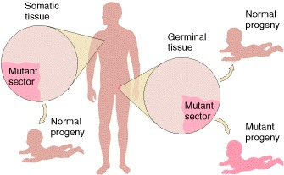
Bioinformatics and Medicine:
Germline vs. Somatic Mutations
"Genes and chromosomes can mutate in either somatic or germinal tissue, and these changes are called somatic mutations and germinal mutations, respectively."
From: An Introduction to Genetic Analysis. 7th ed., Griffiths, et al., W. H. Freeman; 2000, https://www.ncbi.nlm.nih.gov/books/NBK21894/.

Slide 7
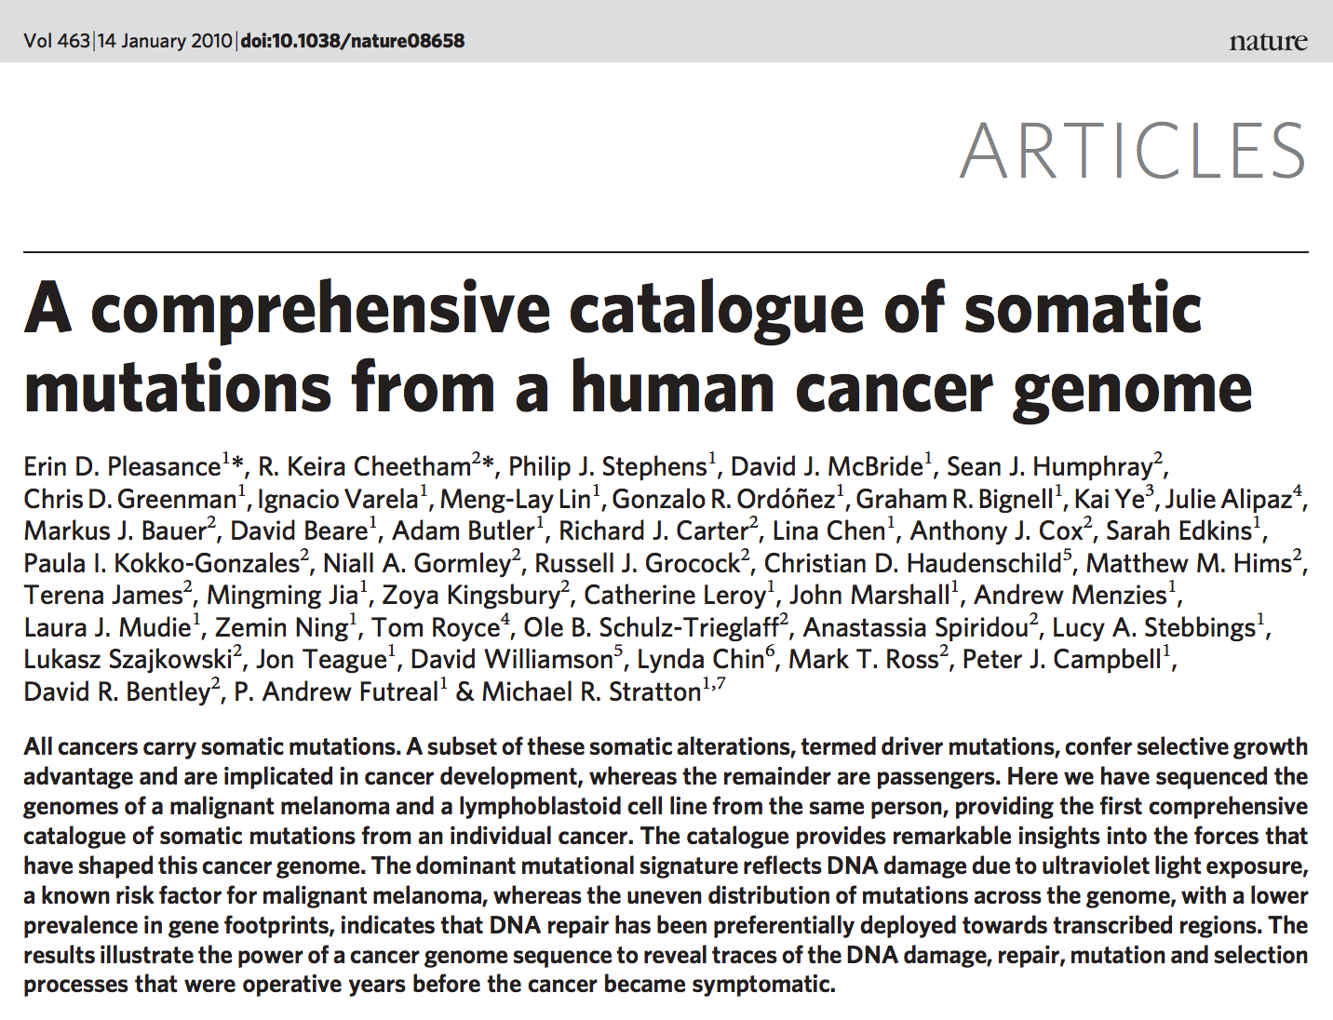

Bioinformatics and Medicine:
Germline vs. Somatic Mutations

Slide 8
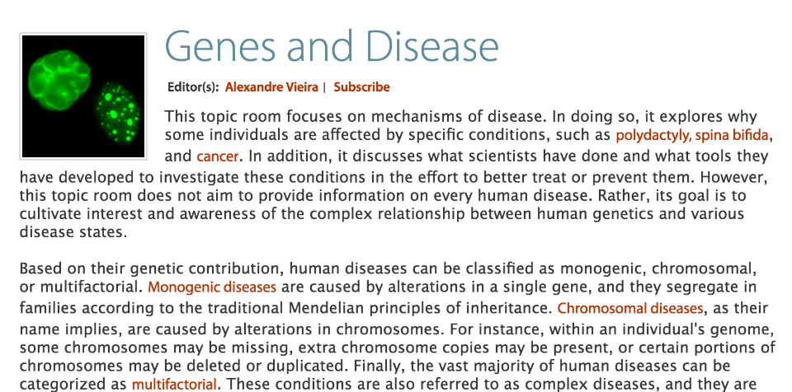
Bioinformatics and Medicine
From Scitable, by Nature Education, NPG,
http://www.nature.com/scitable/topic/genes-and-disease-17

Slide 9
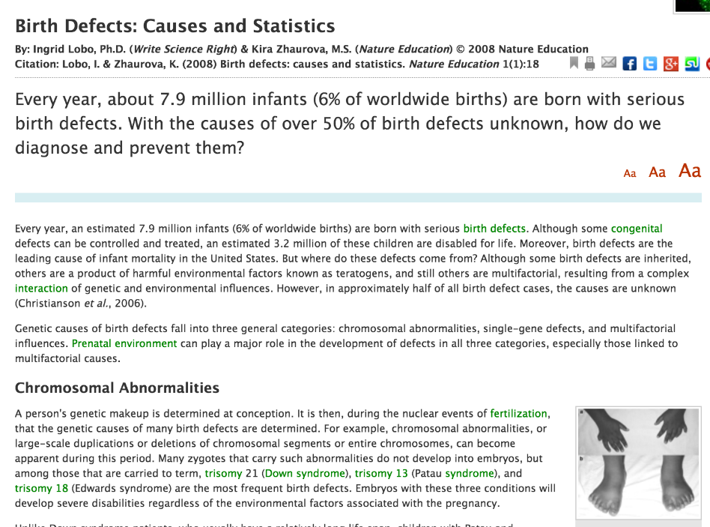
Bioinformatics and Medicine
Genetic causes of birth defects fall into three general categories: chromosomal abnormalities, single-gene defects, and multifactorial influences. Prenatal environment can play a major role in the development of defects in all three categories, especially those linked to multifactorial causes.
http://www.nature.com/scitable/topicpage/birth-defects-causes-and-statistics-863

Slide 10
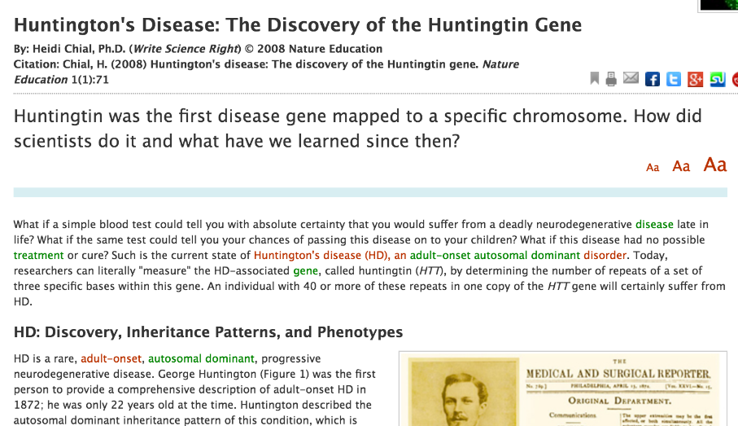
Bioinformatics and Medicine
http://www.nature.com/scitable/topicpage/huntington-s-disease-the-discovery-of-the-851

Slide 11
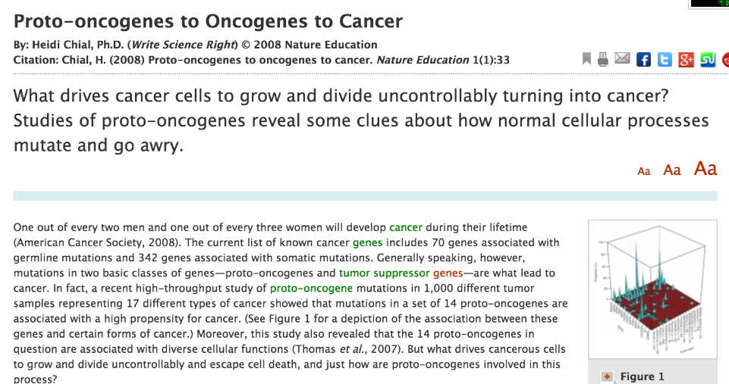
Bioinformatics and Medicine
http://www.nature.com/scitable/topicpage/proto-oncogenes-to-oncogenes-to-cancer-883

Slide 12
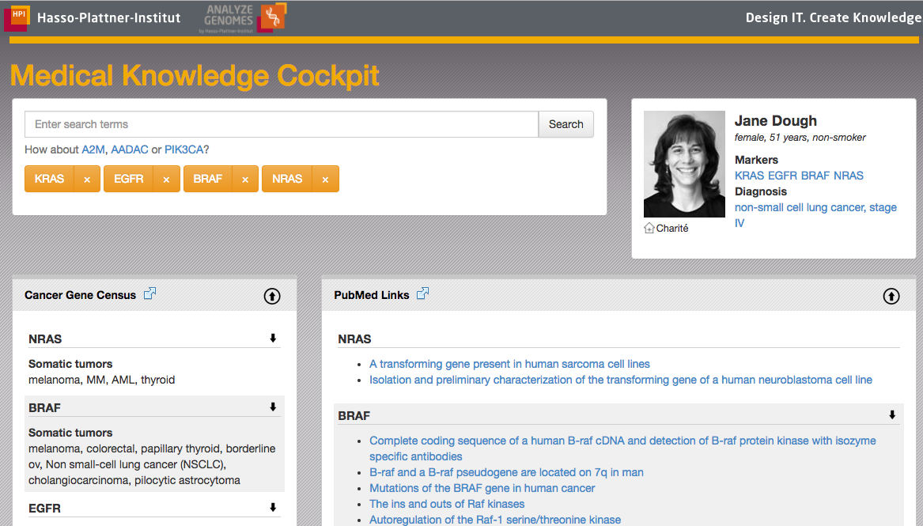
Bioinformatics and Medicine
Code of Life, when computer science meets genetics, HPI MOOC,
https://open.hpi.de/courses/ehealth2016, https://we.analyzegenomes.com/

Slide 13
Bioinformatics and Medicine: Data Science Applications
Bibliology & WWW programming
GWAS, Genome Wide Association Studies
SNPs vs phenotypes (disease)
Gene Expression data analyses
Present vs functional
Sequence alignment & similarity analyses (e.g. BLAST)
Cross-species analysis via gene homology/orthology
Gene-gene/protein-protein interaction network analysis
Pathways, reactomics, metabolomics

Slide 14
Bioinformatics and Medicine: Take home messages
Bioinformatics addresses the molecular basis of health and disease.
Genomic variations between individuals, tissues and cells can help explain and address disease.
Bioinformatics and Data Science can be used across the translational spectrum, from basic to clinical science, in medical practice and personal health.

